Slide 1

Group members:
Tamanna Akter (221-15-5298)
Mst. Fatema Akter ( 221-15-6015)
Suriya Akter Sohana(221-15-4745)
Mahamudul Hasan(221-15-6013)
Fariha Mostafa Nishat (Id- 221-15-4873)
Md. Arif Billah ( 221-15-5842)
Abdullah Al Rifat ( 221-15-5954)
Section:61_M

Slide 2
Title: “Regression Analysis: Estimation of Regression model and interpretation on individual regression coefficients.”
Problem: A random sample of 498 people’s income selected.
Where,
Dependent Variable, Y = Happiness
Independent Variable, X = Income

Slide 3
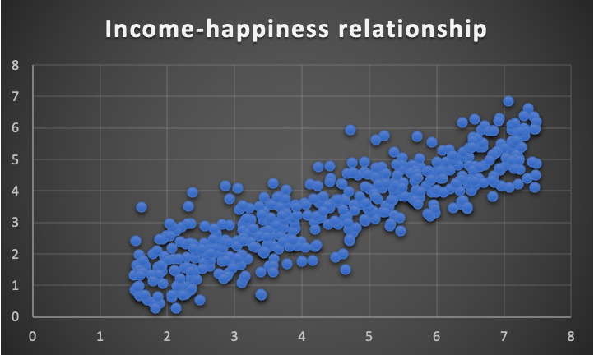
Scatter plot
Strongly positive relationship

Slide 4
Regression Model
β not = 0.2042704 means the predicted value of y is 0.2042704 when the x is 0.
β1= 0.71382551 represent if I change income (x variable) or happiness (independent variable y) 1 Unit. The predicted value of y we expect y will be change into 0.71382551 Unit.

Slide 5
Summary results of regression model
 | Coefficients | Standard Error(SE) | t test | P-value
Intercept | 0.2042704 | 0.088842247 | 2.299248426 | 0.0219055
X (Income) | 0.71382551 | 0.018538534 | 38.50496081 | 3.956E-151

Slide 6
Conclusion:
R square- 75% of variation in dependent variable(happiness) can be explain by independent variable(income).
Test of hypothesis of individual regression coefficient:
P=0.0219055 < 0.05 (The value of intercept is Significant)
P=3.956E-151 > 0.05 (The value of income is not Significant)

Slide 7
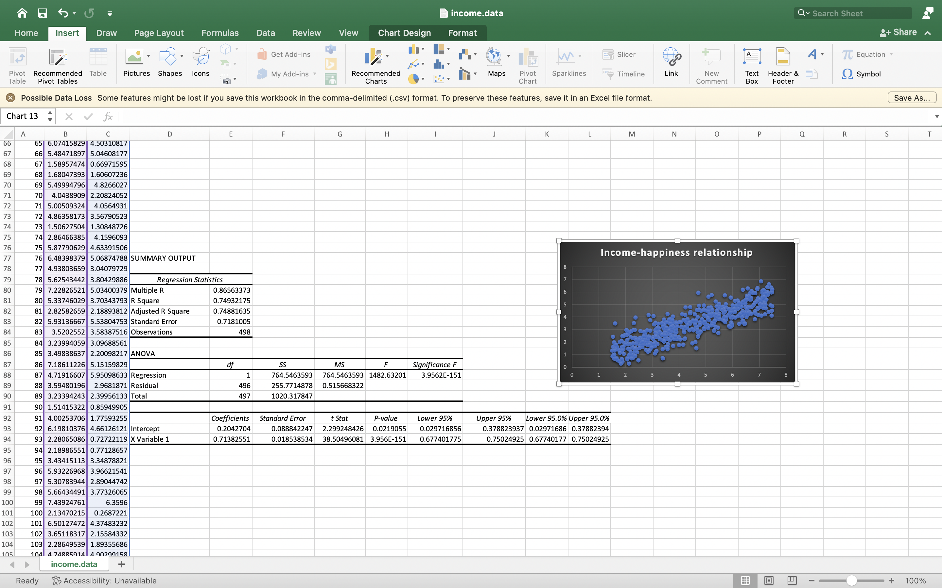
Screenshot:

